Slide 1
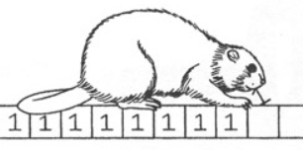

[Poster Describe Research or Software Development Project] Busy Beaver Project Presenter: Or Gamliel Instructor: Dr Anat Paskin Cherniavsky
My project goal project: It will include an important data about Computability theory, and will help to understand the main Busy Beavere problem and will try to offer an optional solutions
2. Introduction:
In the project, we are trying to proceed on one of the open issues on this subject or thinking of new problem by ourselves.
We will need to understand the problem,
writing it and describing it correctly.
organizing, arranging and properly translating all the rare articles to fluent Hebrew, will be a decent task.
3. Methods/algorithms/Alternatives or Design Considerations:
Our way to go will be to read, understand and summarize professional articles on the subject.
Create a glossary for all the many phrases we come across
4. הגישה בה נקטנו
5. Solution Description (Algorithms, Modulation, Patterns, Infrastructure, UI, Functionality)
Visit Us
Scan QRCode for full Instructions

